Slide 1
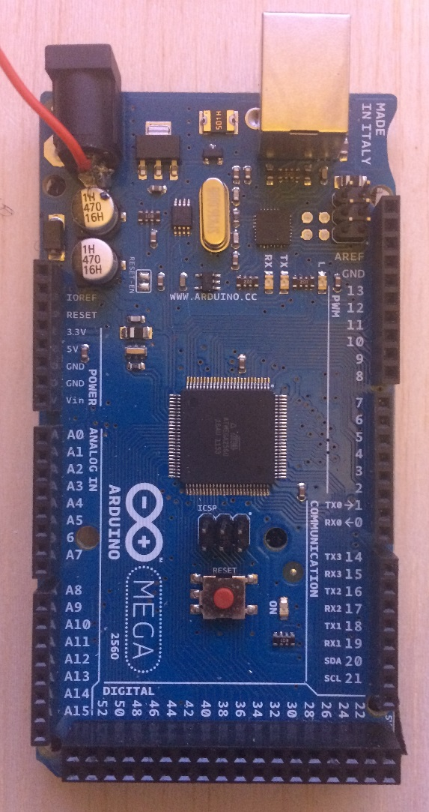
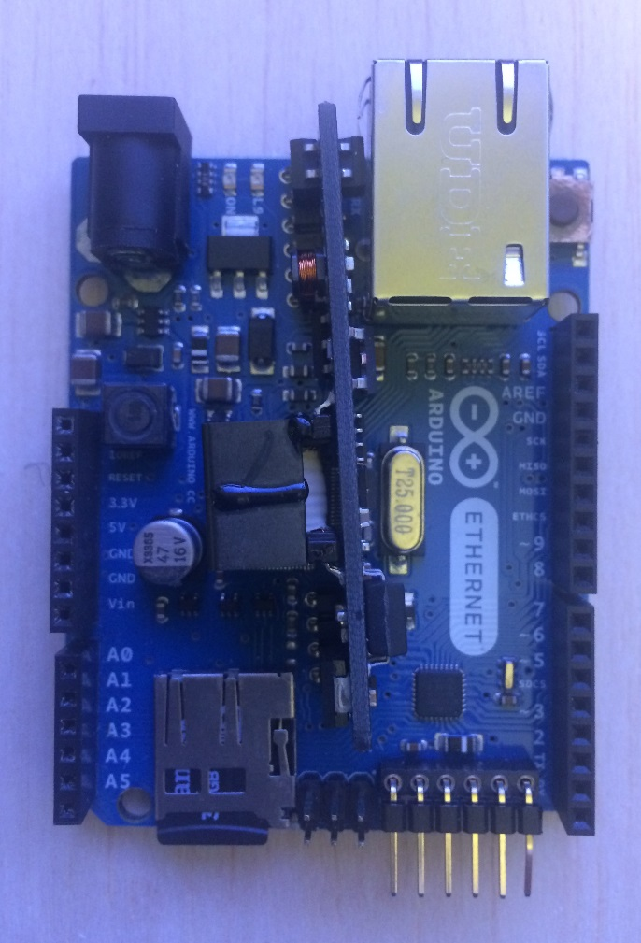
To x 10 Transformer
5v DC Power in
Ethernet cable to Internet
LED’s showing status of lights/ Activity
Serial comms between 2 Arduinos

